Slide 1
FORMS
Ori Calvo, 2017
oric@trainologic.com
https://trainologic.com

Slide 2
Module Introduction
Angular provides the ability to handle forms
Angular provides an easy way to retrieve data from a form and check for valid information
Two approaches for angular form handling
Template Driven(TD)
Reactive Form

Slide 3
Template Driven vs. Reactive Form
Template- Driven approach simply infers the form object from the DOM
Reactive- Form is created programmatically and synchronized with the DOM. We define the structure of the form in typescript code and manually connect it with the html form

Slide 4
TD Approach Basics
Import Form Modules from @angular/forms
Angular will create a form when detecting <form>
HTML tag
import { BrowserModule } from '@angular/platform-browser'; import { NgModule } from '@angular/core'; import { FormsModule } from '@angular/forms'; import { HttpModule } from '@angular/http'; import { AppComponent } from './app.component'; @NgModule({ declarations: [ AppComponent ], imports: [ BrowserModule, FormsModule, HttpModule ], providers: [], bootstrap: [AppComponent] }) export class AppModule { }

Slide 5
TD Approach Basics (Controls)
However, angular will not detect the form inputs by itself
Controls for the rescue!
Controls refers to the JS object in the component class
the name attribute will register a control with the form

Slide 6
TD Approach Basics (Controls)
Example:
<label for="username">Username</label> <input type="text" id="username" class="form-control" ngModel name="username" required>

Slide 7
TD Approach(Submitting & using the form)
Using <button type=“submit”></button> will be a bad practice for submitting an angular form. That is because it will trigger JS event “submit”
Angular takes advantage of that by creating a directive called ng-submit which will treat the entire form as a whole and will be fired when submitting a form (JS default behavior will trigger)
In order to gain access into the form (JS object) and finally into the submitted data of the form, a local reference that equals to “ngForm” must be set
<form (ngSubmit)="onSubmit(f)" #f="ngForm">

Slide 8
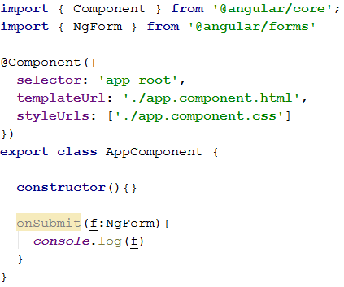
TD Approach(Submitting & using the form)
Index.html
Component app.ts
Local ref & ngForm
<form (ngSubmit)="onSubmit(f)" #f="ngForm">
Import NgForm & create the function with an argument type NgForm.

Slide 9
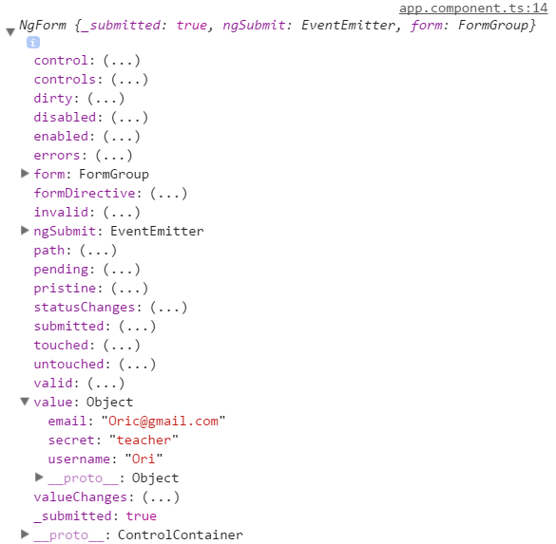
TD Approach(Submitting & using the form)
The example will result an object in the dev tools:

Slide 10
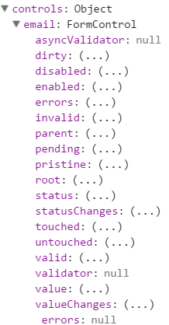
TD Approach (Form State)
Each Controller has unique states which allows us to manipulate the DOM for example:
dirty: Boolean state will change if the user typed in element controller
touched/untouched: state will change if user clicked on the element controller

Slide 11
TD Approach (Access with @viewChild)
@viewChild provide us the ability to access a local reference inside an HTML element
import { Component, ViewChild } from '@angular/core'; import { NgForm } from '@angular/forms'; @Component({ selector: 'app-root', templateUrl: './app.component.html', styleUrls: ['./app.component.css'] }) export class AppComponent { @ViewChild('f') myForm: NgForm; constructor(){} onSubmit(){ console.log(this.myForm) } }
Importing ViewChild,
Setting @ViewChild,
onSubmit function changed.

Slide 12
TD Approach (Validators)
Angular provides us validators in order to validate user inputs
The TD approach let us add validators to the template
Angular dynamically add classes to our form according to the validators and state of the individual control

Slide 13

TD Approach (Validators)
Example:
List of validators: https://angular.io/docs/ts/latest/api/forms/index/Validators-class.html
index.html
Dev tools -> elements
<label for="username">Username</label> <input type="text" id="username" class="form-control" ngModel name="username" required>
ng-invalid state occurred due to the ‘required’ validator.
Remember ng-untouched? Where did we see untouched before?

Slide 14
TD Approach (using element control state to manipulate the DOM)
Angular tracks the state of each element control in the form.
It means that the DOM can be manipulated according to changes in the element controller state
Thanks to the additional classes that angular adds to the element we can also add css styling to it ☺
<button class="btn btn-primary" type="submit" [disabled]="!f.valid">Submit</button>
The example above clearly show us how we can use the state of an element control affect on the form. In the example the user will not be able to click on the submit button unless if the [disabled] property will change to valid. (class ng-valid or ng-invalid will be add to the element).

Slide 15
TD Approach (Validation-error messages)
Angular also has the ability to expose the user to an error message via local reference
Notice the #email local reference? Here, the part of ngModel let us use the element control specific object.
Additionally, a span holds the error message can be add to our form with the *ngIf directive which will expose the error message if the user did not typed a valid email
<label for="email">Mail</label> <input type="email" id="email" class="form-control" ngModel name="email" required email #email="ngModel"> <span class="help-block" *ngIf="!email.valid">Please Enter Valid Email</span>

Slide 16
TD Approach (ngModel & Property bindings)
Until now the use of ngModel was only to select element controls. However, angular grants the ability to set a default selection value
Index.html
With the use of [ngModel] the ability to set default values to the element controller is possible as we set the default value to be ‘pet’, the option ‘Your first pet’ will occur on the form.
App.component.ts

Slide 17
TD Approach (ngModel two way binding)
ngModel is provided with the ability to instantly change according to the input changes
Index.html
App.component.ts
export class AppComponent { @ViewChild('f') myForm: NgForm; defaultValue = 'pet'; answer = ''; constructor(){}
3
1
2
The example present a use case for the ngModel as a two way binding action.
On the one hand the [(ngModel)] in the index.html will change the value of the variable ‘answer’ in the app.component.ts, and the later will interpolate its value to the {{answer}} in the index.html. This results in an ‘on the spot’ immediate change of the <p> tags text.

Slide 18
TD Approach (Grouping controls)
Angular provides the ability to group elements control in the form
With the help of wrapping <div> which contains the ‘ngModelGroup’ directive, we are now able to group form controls
As we mentioned before all the classes that angular dynamically adds to our form & elements controls are also applied to the control's group so manipulating the DOM is valid

Slide 19
TD Approach (Grouping controls)
Styling css according to the group’s state is the same as before.
Set a local reference on the wrapping div equals to “ngModelGroup”
Example: #userData = “ngModelGroup”
<div id="user-data" ngModelGroup="userData"> <div class="form-group"> <label for="username">Username</label> <input type="text" id="username" class="form-control" ngModel name="username" required> </div> <button class="btn btn-default" type="button">Suggest an Username</button> <div class="form-group"> <label for="email">Mail</label> <input type="email" id="email" class="form-control" ngModel name="email" required email #email="ngModel"> <span class="help-block" *ngIf="!email.valid">Please Enter Valid Email</span> </div> </div>
Noticing the wrapping <div> with the ngModelGroup directive on it?
The example creates a group which consist of the username controller and the email controller.

Slide 20
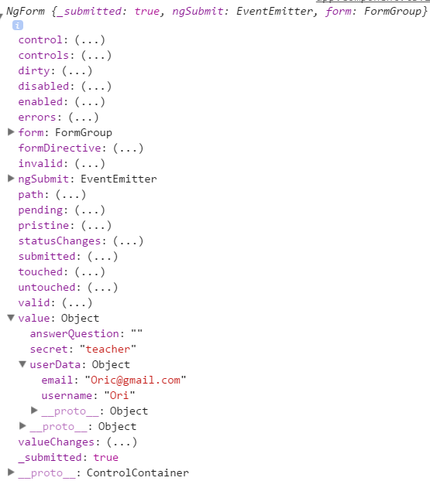
TD Approach (Grouping controls)
Result:
Notice the group ‘userData’?
Where did that name comes from?
Look the ngModelGroup directive
It is equals to that name

Slide 21
TD Approach (Radio Buttons)
Angular handles the forms radio buttons very easy
With the use of ngModel we can set each radio button as a controller
Index.html
app.component.ts
The example reflects a common used case with radio buttons. The class holds a list of genders while the index.html looping through each gender and set it as a controller for the form.
export class AppComponent { @ViewChild('f') myForm: NgForm; defaultValue = 'pet'; answer = ''; genders = ['Male','Female']; constructor(){}
}

Slide 22
TD Approach (Extract the data)
Finally, angular let us extract the data and with ease by accessing each controller by its name thanks to @ViewChild
Remember? Setting our form with the @ViewChild which allow as to access local reference in order to retrieve data

Slide 23
TD Approach (Extract the data)
app.component.ts
Index.html
<div class="row" *ngIf="submitted"> <p>UserName: {{user.username}}</p> <p>Email: {{user.email}}</p> <p>Secret Question:
{{user.secret}}
</p> <p>Gender: {{user.gender}}</p> </div>
export class AppComponent { @ViewChild('f') myForm: NgForm; defaultValue = 'pet'; answer = ''; genders = ['Male','Female']; submitted = false; user = { username:'', email:'', secret:'', gender:'' }; constructor(){} onSubmit(){ this.submitted = true; this.user.username = this.myForm.value.userData.username; this.user.email = this.myForm.value.userData.email; this.user.secret = this.myForm.value.secret; this.user.gender = this.myForm.value.gender;
}
}
The example reflects the TD approach for extracting data.
The function onSubmit has all the data extraction keep in mind that the form contains a group of controls named ‘userData’.

Slide 24
TD Approach (Extract the data)
Angular’s form module let us reset the form
this.myForm.reset();

Slide 25
Reactive Form
As mentioned, Reactive form is created programmatically (typescript code)
Angular provides us tools to create such a form with ease

Slide 26
Reactive Form (setup)
app.component.ts
app.module.ts
import { FormGroup } from '@angular/forms'
import { ReactiveFormsModule } from '@angular/forms'; @NgModule({ declarations: [ AppComponent ], imports: [ BrowserModule, ReactiveFormsModule, HttpModule ], providers: [], bootstrap: [AppComponent] }) export class AppModule { }
Importing ReactiveFormsModule rather than Form Module in order to use the reactive approach
export class AppComponent { signUpForm: FormGroup; constructor(){} }
Create a property which will hold my form. The property must be type FormGroup for it will hold all of my controls

Slide 27
Reactive Form (Creating the form)
When creating a reactive form, it is best to use a life cycle hook which is called before the template is rendering
Creating out controls group with the help of FormGroup
ngOnInit(){ this.signUpForm = new FormGroup({ 'username': new FormControl(null), 'email': new FormControl(null), 'gender': new FormControl('male') }) }
Forming an object with the fields names and controls by using FormControl. The FormControl contains 3 arguments:
A default value/state when initiating the form.
A single nor array of validators.
A potentially asynchronous validators.

Slide 28
Reactive Form (Creating the form)
As of now, angular cannot identify which control belongs to an element
When creating a form in angular, while angular detects <form> tags the default behavior as we learned earlier is automatically creating a form. Which is not the correct behavior among the reactive approach
Luckily, we can use the directive ‘formGroup’. It is most important to encapsulate the directive with the property bindings square brackets for implementing our form in it

Slide 29
Reactive Form (Creating the form)
Our form is synchronized with our typescript code.
Setting up a controls in the form take another directive called ‘formControlName’, which will bind the control to the specific chosen formGroup property
<form [formGroup]="signUpForm">
<label for="username">Username</label> <input type="text" id="username" class="form-control" formControlName="username">

Slide 30
Reactive Form (Submit)
Similarly to the TD approach an ‘ngSubmit’ event must be set in order to submit a form
However, setting up a local reference as before is not needed. That is because:
The default behavior of angular for creating a form is no longer active
Thanks to the reactive approach, the form is created in typescript, therefore, all methods and properties are available at hand

Slide 31
Reactive Form (Submit)
Index.html
<form [formGroup]="signUpForm" (ngSubmit)="onSubmit()">
app.component.ts
onSubmit(){ console.log(this.signUpForm) }

Slide 32
Reactive Form (Validators)
The reactive approach do not support validators via the HTML template, but rather on the typescript code
import { FormGroup,FormControl, Validators } from '@angular/forms'
Import the validators.
Set a single of array of validators in the typescript code.
Be aware! When using validators do not invoke validators methods (for example ‘required()’ ). Instead, only refer to the methods (as the example does).
That is because angular will execute the methods by itself whenever it will detect a change
ngOnInit(){ this.signUpForm = new FormGroup({ 'username': new FormControl(null, Validators.required),
'email': new FormControl(null, [Validators.required, Validators.email ]), 'gender': new FormControl('male') }) }

Slide 33
Reactive Form (Access Controls)
Reactive approach grants the ability to access any controls in the form for manipulating the DOM etc
Using the get() method provided by the current approach accept an argument which will be a path of the control that we would like to access
<label for="username">Username</label> <input type="text" id="username" class="form-control" formControlName="username"> <span *ngIf="!signUpForm.get('username').valid && signUpForm.get('username').touched"> Please Enter a username. </span>
The example reflects a common use case for manipulating the DOM with the help of an element control.
When the element control’s state is invalid or touched, a span will appear notifying the user to enter a valid username

Slide 34
Reactive Form (Grouping Controls)
The reactive approach provides the ability to group controls using ‘FormGroup’
The grouped controls should be wrapped up in <div> tags and should contain the ‘formGroupName’ directive equals to the property name of the groups
A ‘FormGroup’ will be nested inside the main ‘FormGroup’ in the type script code

Slide 35
Reactive Form (Grouping Controls)
Wrapping <div>
Index.html
app.component.ts
<div formGroupName="userData"> <div class="form-group"> <label for="username">Username</label> <input type="text" id="username formControlName="username"> <span *ngIf="!signUpForm.get('userData.username').valid && signUpForm.get('userData.username').touched"> Please Enter a username. </span> </div> <div> <label for="email">email</label> <input type="text" id="email" formControlName="email"> </div> </div>
ngOnInit(){ this.signUpForm = new FormGroup({ 'userData': new FormGroup({ 'username': new FormControl(null,Validators.required), 'email': new FormControl(null,[Validators.required, Validators.email ]) }), 'gender': new FormControl('male') }) }
Nested FormGroup which holds the username & email controls
After creating a group the get method’s path needs to be updated according to the new form group

